Slide 1
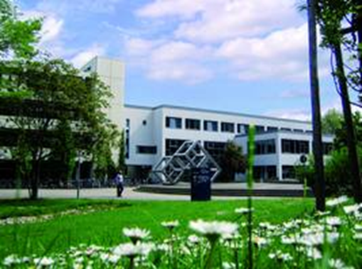
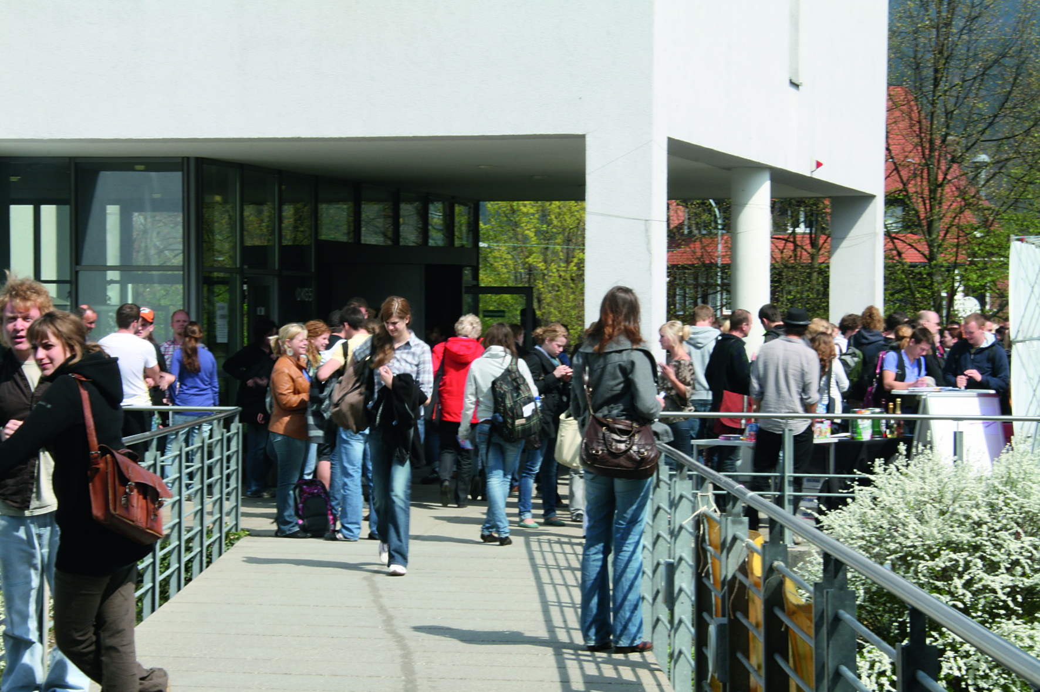
University of Education Freiburg
Dr. Verena Bodenbender
Director of the International Office

Slide 2
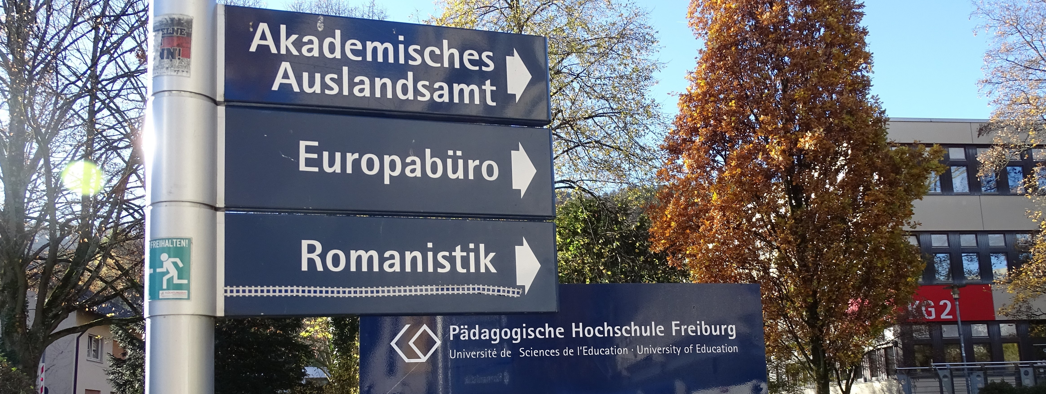
Pädagogische Hochschule Freiburg
Around 4800 students, all enrolled in programs with a focus on Education
320 professors and academic staff
130 non-academic staff

Slide 3
Our cooperation
We have a long history of exchanging students and faculty members
For a certain number of students from York, PH Freiburg offers a scholarship
In 2024, the monthly amount will be 1000€, which will cover accommodation, health insurance and other living costs.

Slide 4
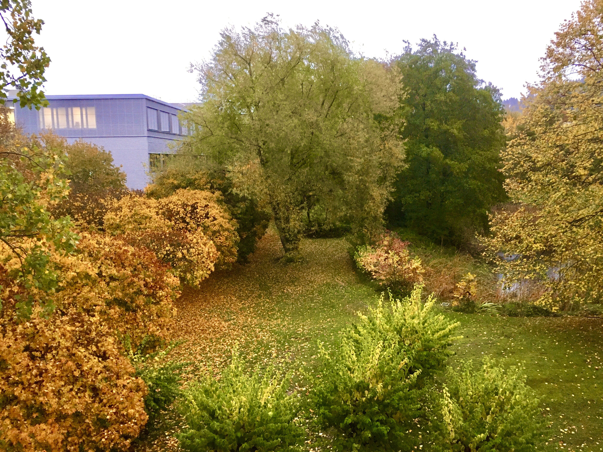
Accommodation
We guarantee accommodation in our student dorms.
Some dorms are on campus, others in other areas in Freiburg.
You will be able to reach the university either by bike or tramway.

Slide 5
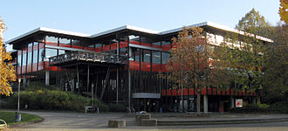
Administrative help
My colleague Julia Salzmann provides help with all administrative tasks.
Once you are nominated, she will invite you to a Zoom meeting with all other international students to guide you through all steps in the application process.

Slide 6
Important notice
Please read all of our mails thoroughly. We promise we won‘t put any information in those mails that isn‘t important.

Slide 7
Faculty of Education
York students usually take classes at the Faculty of Education. One of the classes is taught by a professor from York University.
Other classes can be chosen in our English Department (focus on TESL) or the French Department (focus on FLE) – these classes are taught in English / French.
Taking a class in Geman is mandatory

Slide 8
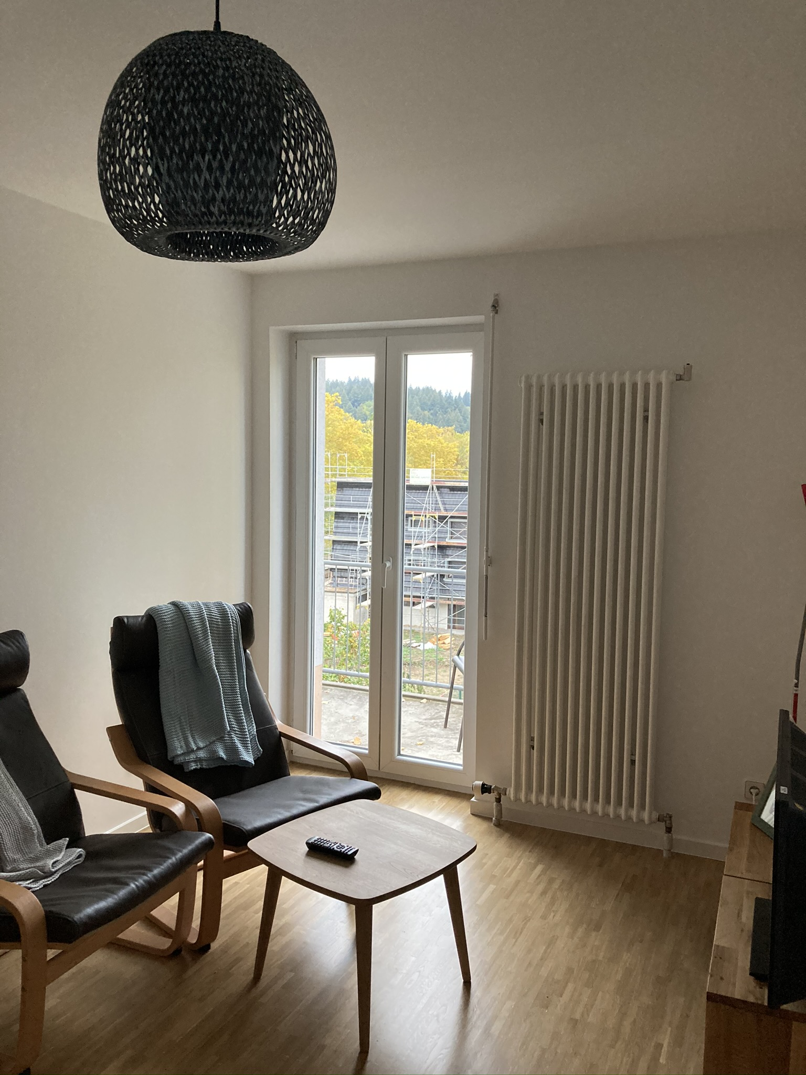
Exchange of Faculty Members
Each year, a faculty member of York University spends 4 weeks at PH Freiburg to teach.
The teaching is usually on one (whole) day per week.
Accommodation is assured in one of our guest apartments.

Slide 9
I hope to see you in Freiburg!

