Slide 1
Open Pedagogy as a Creative Process: A Transnational Exploration of Student-Centred Learning Design
Teaching in Focus Conference 2019
York University
May 15th, 2019
Dominique Scheffel-Dunand, Liam Bekirsky,
Agnès Lemesre-Valy, Laura Waddell
Notes:
Laura

Slide 2
Presentation Overview
Welcome and presenter introductions
Experience Open Pedagogy
Project overview
Challenges, reflections, and possibilities
Discussion and concluding remarks
Notes:
Laura

Slide 3
What is Open Pedagogy?
The foundations of an open pedagogy are:
Participatory technology
Innovation and creativity
Sharing ideas and resources
Reflective practice
Mutual trust in openness
A connected community
Learners as designers
Peer review
The principles of open pedagogy include the 5 Rs:
Reuse
Retain
Revise
Remix
Redistribute
Notes:
Laura

Slide 4
What others say about Open Pedagogy
“We think about Open Pedagogy as an access-oriented commitment to learner-driven education AND as a process of designing architectures and using tools for learning that enable students to shape the public knowledge commons of which they are a part.“
Open Pedagogy Notebook
“Open pedagogy is the practice of engaging with students as creators of information rather than simply consumers of it. It's a form of experiential learning in which students demonstrate understanding through the act of creation. The products of open pedagogy are student created and openly licensed so that they may live outside of the classroom in a way that has an impact on the greater community.”
University of Texas at Arlington
Notes:
Laura

Slide 5
About the project
WHO: 3-5 instructors/mentors and 66 students over four phases of development
WHAT: Student-created open educational resources (OER) on three topics:
Interculturality/intercultural communication
Plurilingual communication
Information literacy and academic competencies
HOW: Academic Innovation Fund Grant to recruit students outside of a classroom setting to create these resources.
Notes:
(Liam - 5-10)
Within the context of the development of the “Certificate in Civic and Social Stewardship” to debut at Glendon in 2019-2020, our 2018-2019 AIF “Bilingual Open Educational Resources for Civic and Social Stewardship” had the goal of developing three modules to be used by instructors and students in the certificate, as well as in diverse courses across the university, activities outside of the university, or within projects at the new Makerspace at Glendon.
(Mention SDGs - related to civic and social stewardship).

Slide 6
Project timeline
M1 M2 M3 Prototyping
Interculturality Plurilingualism Academic Literacy Workshop
Fall 2018 Winter 2019 March 23 - 24 May 2 - 3
In class / online In class/ online Ideathon
Weekly-meeting Weekly-meeting
Roundtable
4 bilingual GL students, 3 International GL students, 8 bilingual high school students in the IB program, working in teams of 4
(All new to the process)
8 Glendon students 8 new Glendon students on exchange in France, working in pairs
(1 new to the process)
8 experienced GL students, 8 experienced GL students on exchange in France, 9 new French students on exchange at GL
25 Lassonde students
(mix of engineering and computer science), 6 experienced Glendon students
Notes:
Liam
Resources provided:
M1: database of resources on intercultural communication developed in advance (Barely used)
M2: Initial roundtable with topic experts from Glendon (questions developed by students and mentors); follow up with one instructor after development of some activities. Students creating database themselves.
M3: three workshops on Day 1 of the workshop on academic culture, SPARK, and how to create a storyboard; students’ own experiences of learning different academic environments.
M4: XXXXXXX
M1: Really learned open pedagogy: learning about and working with open pedagogy; working with people they didn’t know; learning how to create open educational resources by adding to the database (even if they did not use many resources from it to back up their own modules - instead, using things they found online themselves as resources.)
M3: Why an Ideathon? Think, Hackathon, but to come up with ideas.
During a short period of time, students who did not know each other had to come together and work.
BIG steps: transnational open pedagogy, and using groups in virtual communication for the totality of the project. Putting students in a creative space for a short period of time.
“Light” COMPETITION, but mostly COLLABORATION

Slide 7
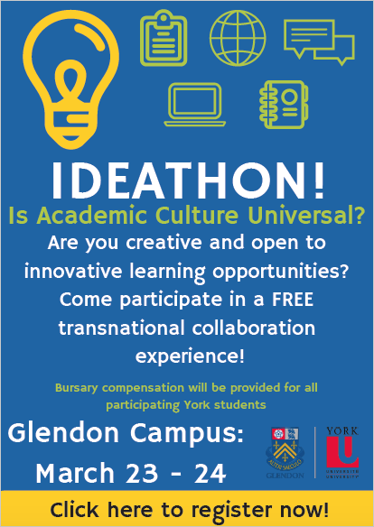
M3 - Information Literacy and Academic Competencies
March 2019
Notes:
Liam

Slide 8
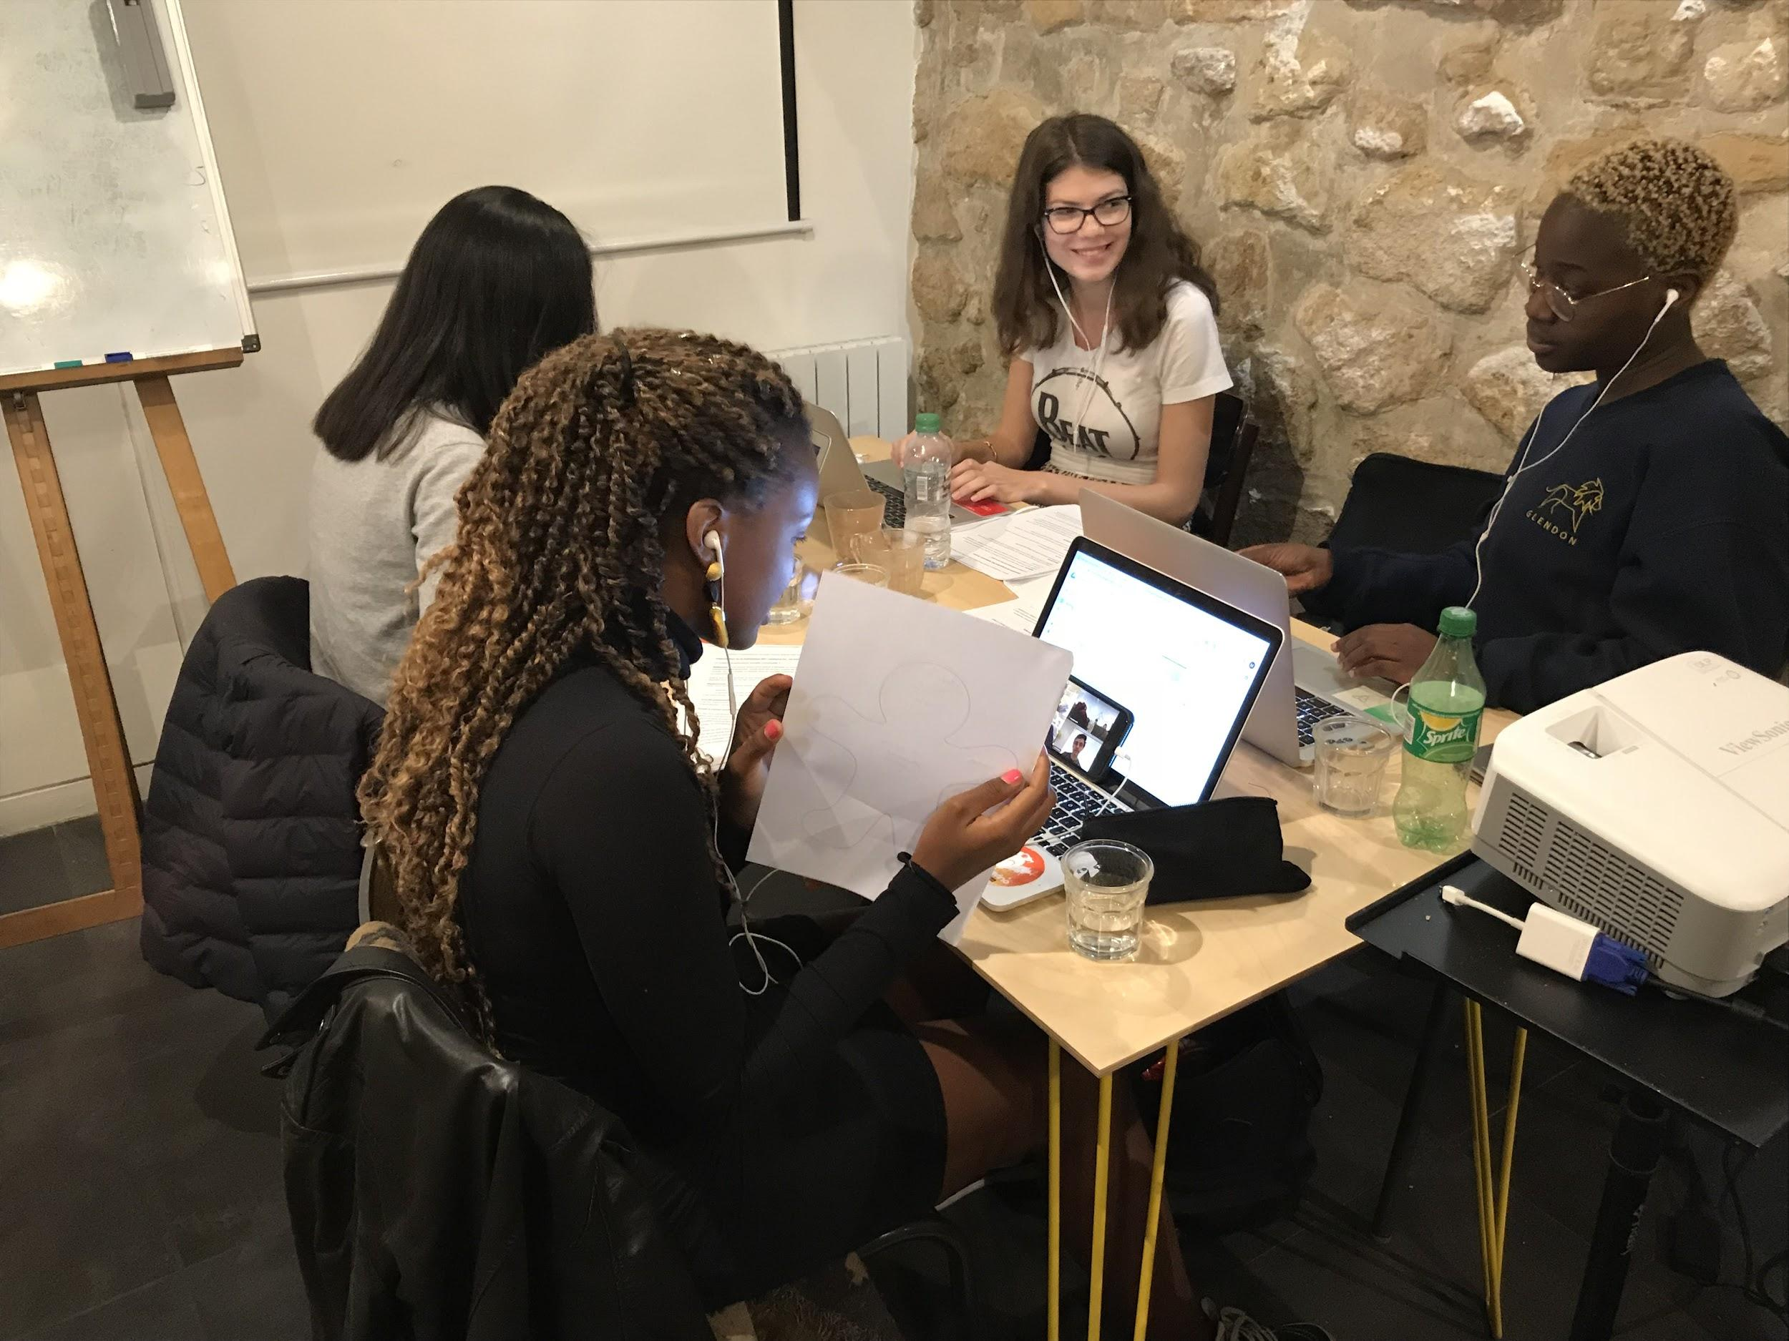
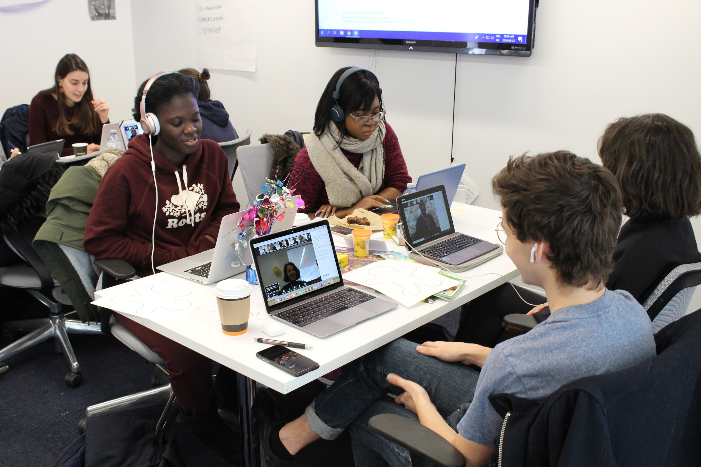
Transnational Collaboration - Paris and Toronto
Paris - Anticafé Beaubourg
Toronto - Glendon
Notes:
Liam

Slide 9
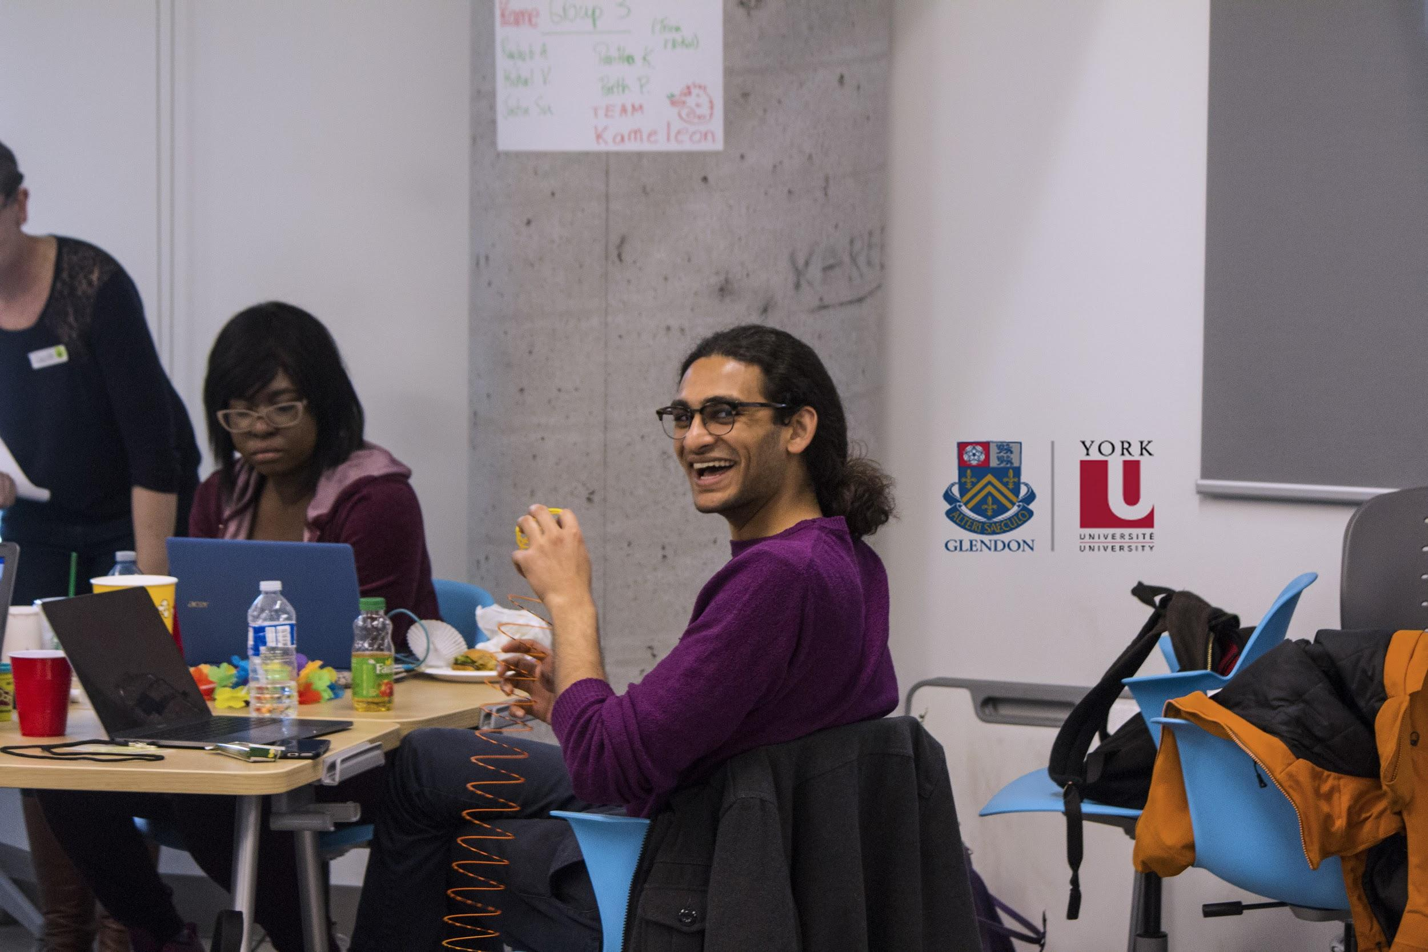
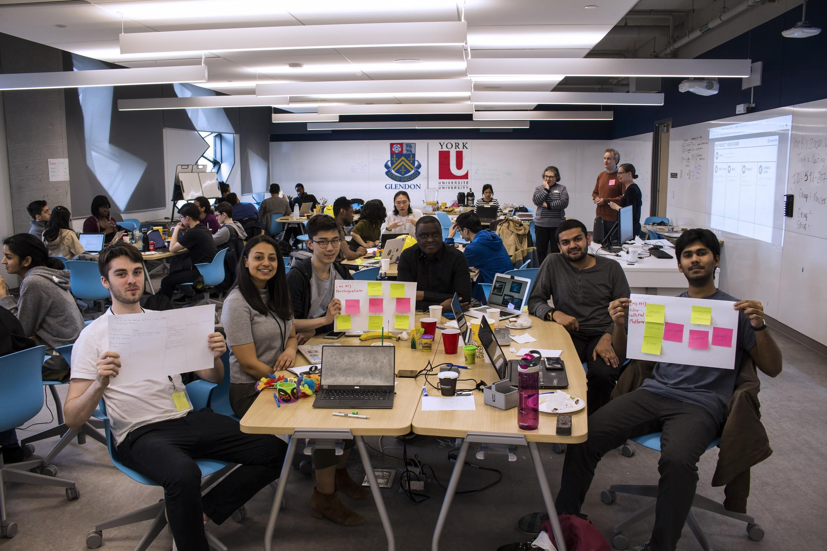
Glendon-Lassonde Prototyping Workshop
Notes:
Liam

Slide 10
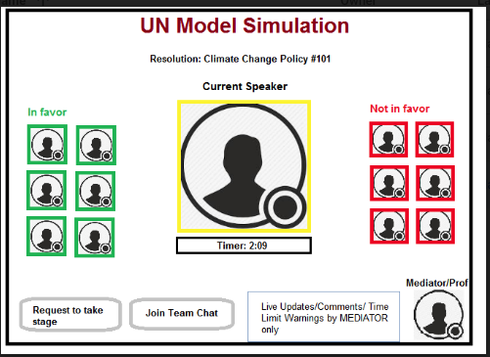
Prototypes
Notes:
Liam

Slide 11
M1 Activities Created
Gender and Reproduction (reflection learning activity, branching scenario, social comparison activity; learning about ethnocentrism, online group discussion)
Aging Population (interactive map, collaborative discussion activity)
Inequalities in access to education (think-pair-share, debate on discrimination)
Refugees (media analysis activity, mock debate, reflection activity)
Glendon student comment: we enjoyed the freedom to explore a topic the group was interested in (even if it took awhile to decide on one) and not worry about the final evaluation.
Notes:
Laura
This has a direct link with the Social Development Goals; students used those as ‘wicked problems’ to solve with their activity topics.

Slide 12
M2 Activities Created (selected for prototyping)
Breaking News: Language learning and comprehension
Using Plurilingualism to collect multilingual sources in the context of a research project
Give me the short version
Idioms activity
The hunt for words and expressions across languages
Plurilingualism and accents
Code-switching
Slang activity
One for all, all for one: Model UN simulation
International Pen Pals: Language and cultural exchange
The Nissart Dialect
Glendon student reflection: this is not a syllabus; (we get to) deconstruct a bit, have more different ideas.
Notes:
Laura
In total, there was at least double this; only these were selected (by one of our graduating students) as complete for consideration at the prototyping workshop.
Student creating their own database; found that more helpful

Slide 13
M3 Activities Created (selected for prototyping)
Venn Diagram (between two different academic cultures)
Competency mind map between academic cultures
The reign of the quote; quoting activity; citation activity; identifying credible sources
Path to success (translating degrees across cultures and interests)
MeeTeach (social media network for students and teachers, to establish a good rapport with their instructors)
Tinder for Academics (getting to know cultural norms on campus - dating life, consent, and social events)
I write therefore I am (learning how to write an essay in various forms in different countries)
Perceptions survey
Introducing academic cultural differences
Vlog with an exchange student/Video Pen Pal
Interactive map on academic cultures
Academic slang dictionary
Buddy program
Email to the professor
Building guidelines on academic expectations
Alternative research resources
The survivor of academic culture (judging research resources)
Understanding hierarchy student/teacher
Exchange student reflection: I also learned how to work in a group without just relying on myself to do all the work, [and] to share the work with full trust in others.
Notes:
Laura
The more we move forward into the project; these are not even all of the activities that they came up with.
The more the students use the pedgaogy, the more they create, as they become comfortable expressing themselves, AND comfortable thinking outside of the box. Less fears about about the final evaulation and able to just brianstorm.
ALSO more comfortable in using what they know. This module was not resource based, but based on their own experiences moving between academic cultures.
Showing us the reason for trust, collaboration, and outside of the box thinking.

Slide 14
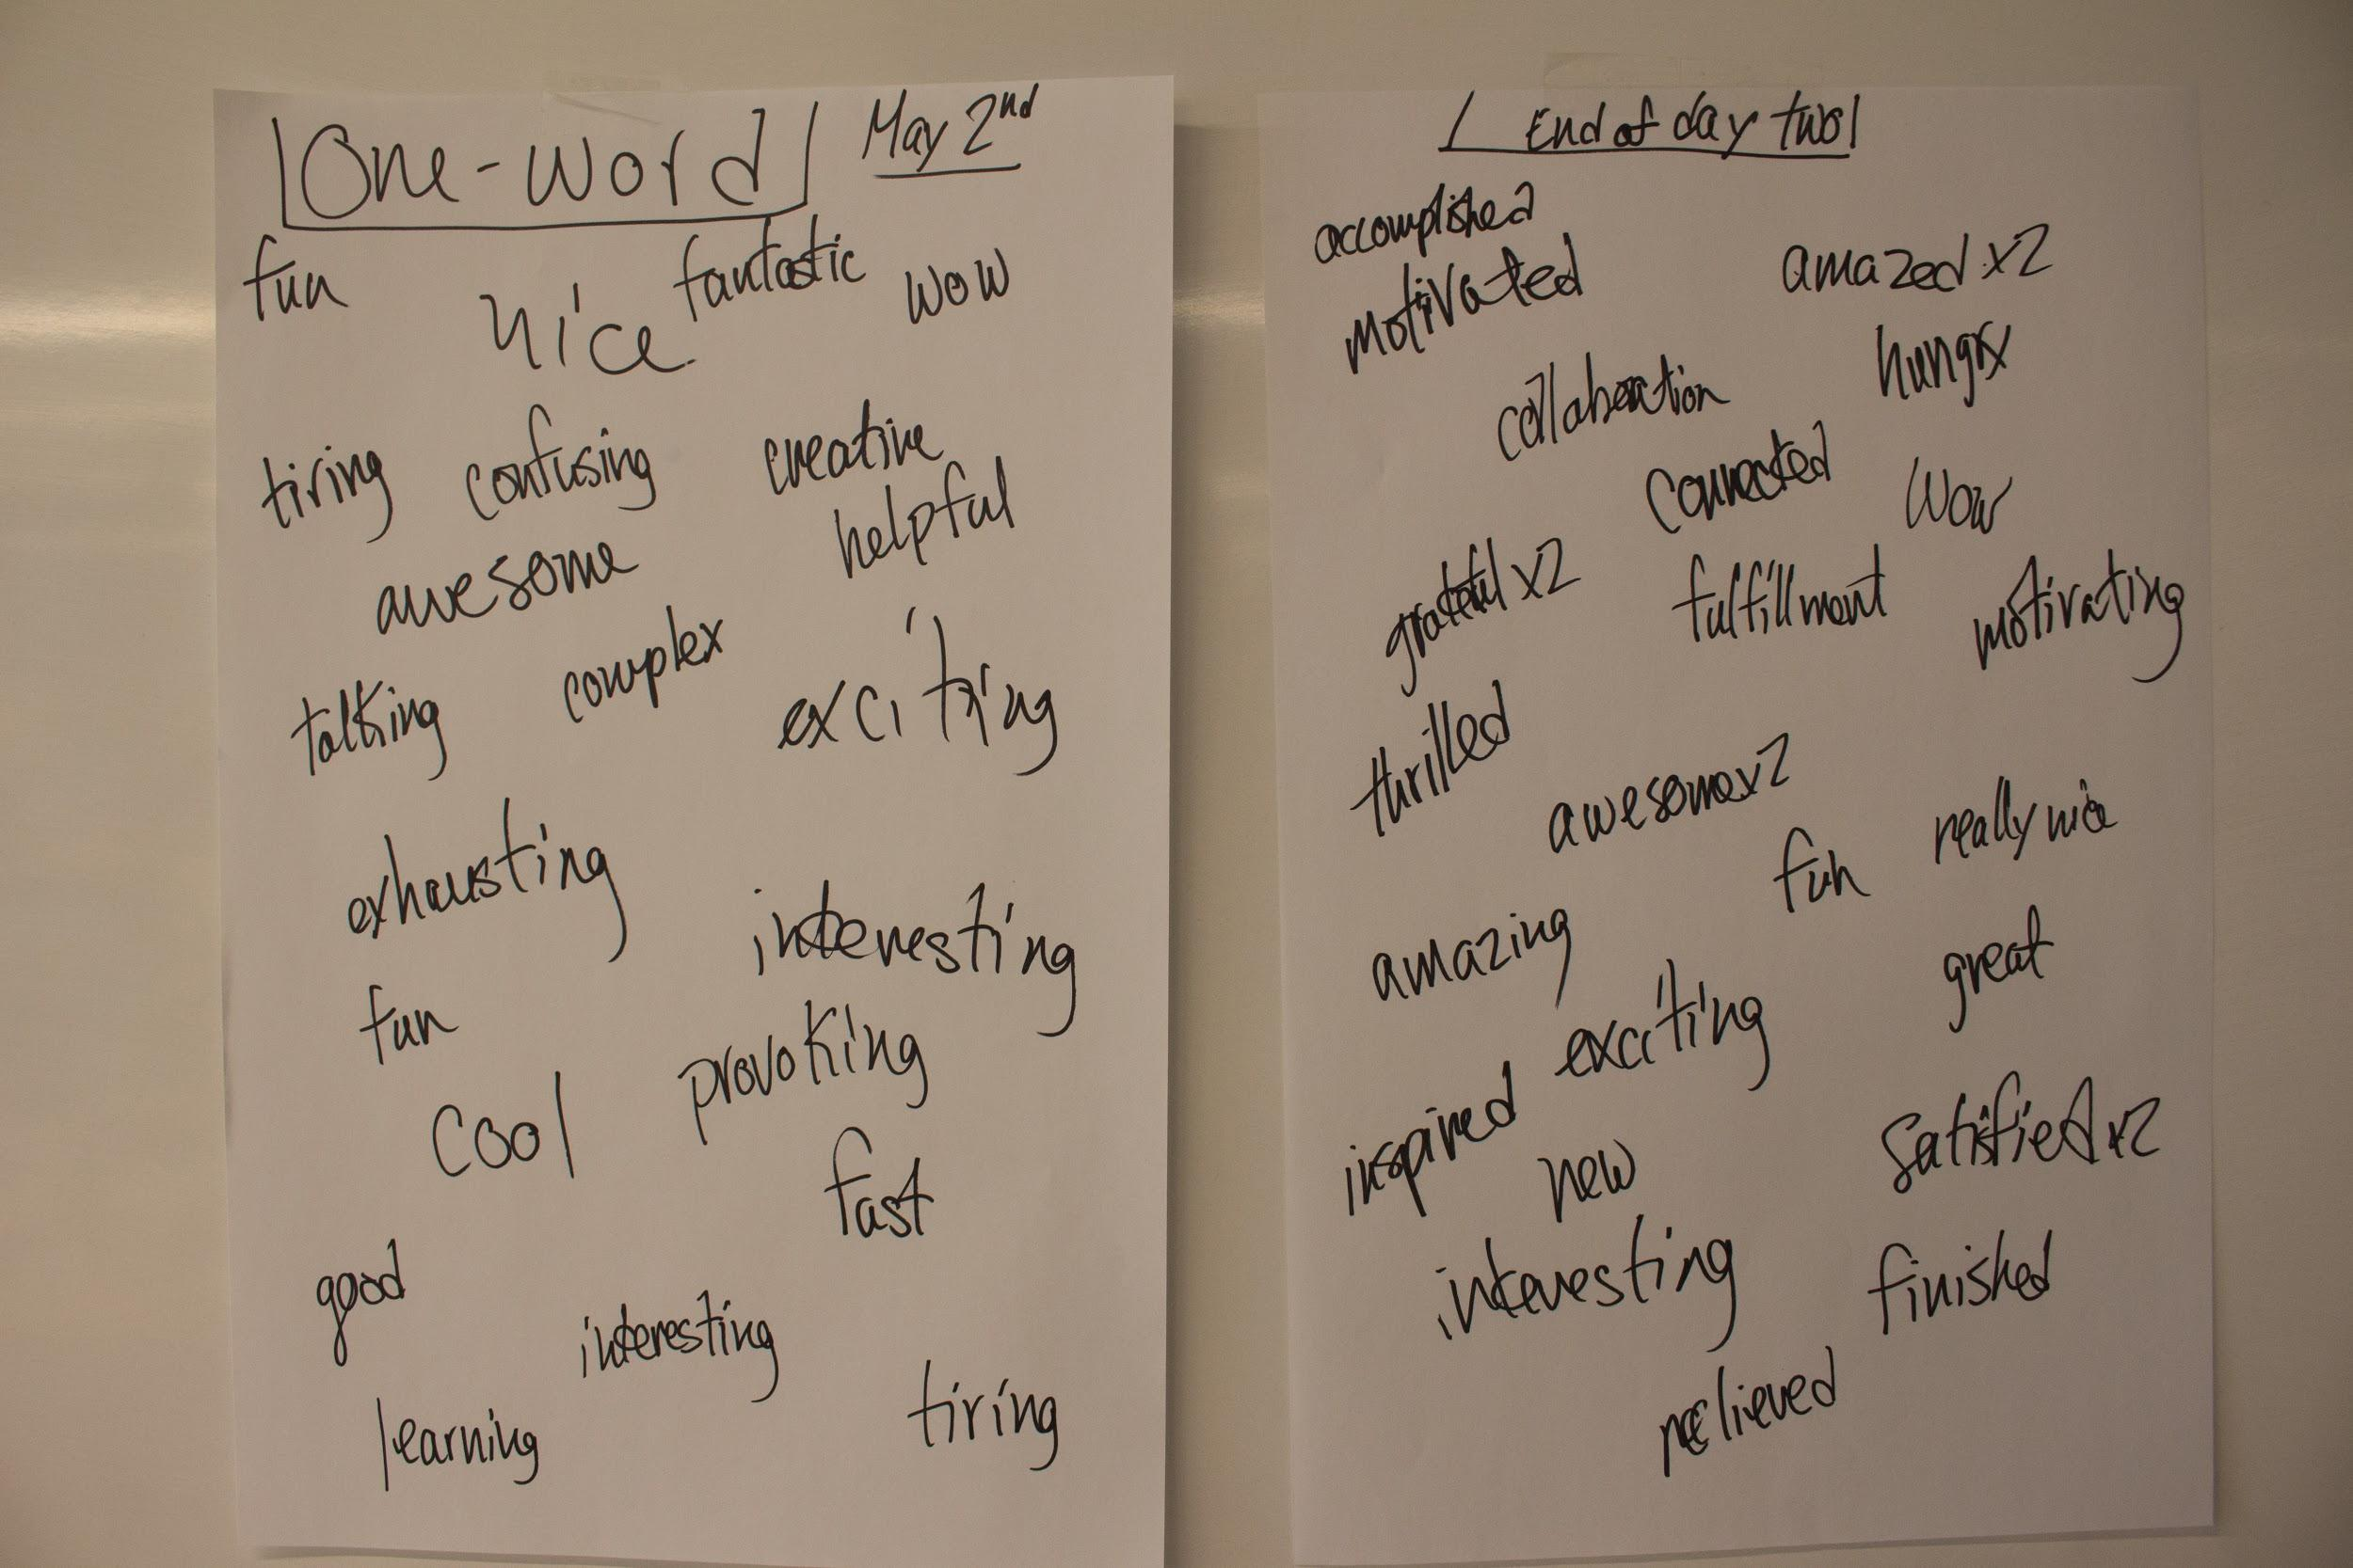
Prototyping workshop student reflections
Notes:
Laura

Slide 15
Challenges we experienced with open pedagogy
Technology
Engaging students and dealing with absenteeism
New students; taking time to get to know (and trust!) each other
Tension between creativity and assessment
Assessment: process or product? (Are these the same thing?)
How to manage the amount of resources created
Notes:
Liam
Tech
Creativity and assessment
Engaging students and absenteeism (even with option of virtual meeting)
New students
Assessment:

Slide 16
Reflections on our process
Something learned from each module and creative process
Increase in the number of activities created
Comparative feedback from students who participated in more than one module
An adventure in trust, academic supervision, support and authority
The importance of reflection and feedback
Notes:
Liam
In general:
The number of activities created in each module: the more the students use open pedagogy, the more creative they became (remixing activities along the way)
Comparative feedback from students who participated in more than one moduleNumber of activities created in each module - the more the students use open pedagogy, the more creative they became (remixing activities along the way)
SPARK
Trust, academic supervision, support and authority
We did NOT evaluate the product - but provided feedback throughout. Have amazing end products.

Slide 17
Possibilities for Open Pedagogy
Taking time and building trust: The benefits of in-person meetings
Learners to creators
Balancing autonomy and guidance
Developing and enhancing the 21st Century Competencies
Opportunities to enhance student engagement and motivation
Notes:
Liam

Slide 18
Discussion
What would be your biggest challenge to using open pedagogy?
What would motivate you to use open pedagogy?
How would you introduce assessment into open pedagogy?
What is being assessed, students or product?
Who is doing the assessment? Ex. Experts, users, or peer-review?
Are open educational resources also academic resources? (And how can the university better support their creation?)
Notes:
Laura

Slide 19
Questions?
Project Contact: gnl@yorku.ca
Dominique Scheffel-Dunand: dsdunand@glendon.yorku.ca
Liam Bekirsky: bekirsky@glendon.yorku.ca
Agnès Lemesre-Valy: alemesre@glendon.yorku.ca
Laura Waddell: lwaddell@yorku.ca

Slide 21
Experience Open Pedagogy
Go to Kahoot Website: https://kahoot.it/
(Or download the application to your mobile device)
Enter PIN: 395781
Play!
Notes:
Laura

