Slide 2
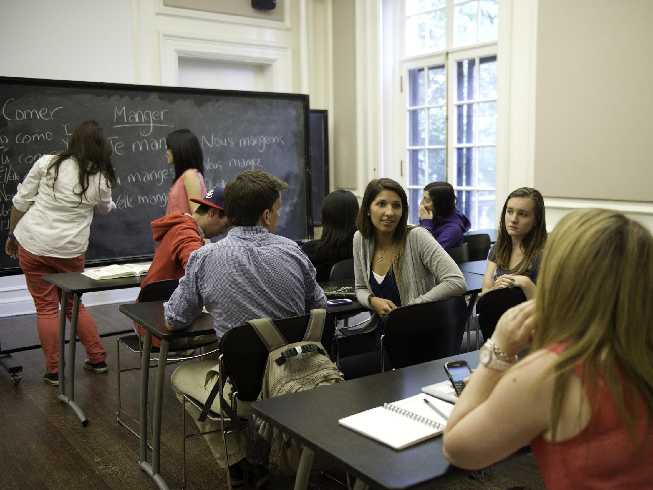
Leading from the Middle:
Lessons Learned from Developing Awareness of and Competency for Globally Networked Learning among Faculty, Staff, and Students at York University
COIL 2018
Friday, March 16, 2018
Dominique Scheffel-Dunand, GNL Project Lead
Lisa Endersby, Educational Developer, Teaching Commons
Nausheen Quayyum, GNL Project Assistant

Slide 3
Our Agenda
Welcome & Presenter Introductions
GNL Project Overview
Leading from the Middle: Engaging Your Institution in Integrating GNL
Benefits and Barriers: Lessons Learned from the GNL Project Team
Concluding Remarks & Q&A
Notes:
LISA
Welcome and Presenter Introductions:
Dominique Scheffel-Dunand is Associate Principal of Research & Graduate Studies at Glendon College in York University. She is also the Project Lead of Globally Networked Learning at York.
Lisa Endersby is an Educational Developer at Teaching Commons and is a PhD student at York.
Nausheen Quayyum is the GNL at York Project Research Assistant and is a PhD Candidate at York.

Slide 4
Internationalization and the GNL Project at York: An Overview
Internationalization efforts at York University prior to 2015 and the conceptualization of the Globally Networked Learning Project at York University as an example of internationalization of higher education
The GNL Project at YorkU began as a Provost-driven initiative in 2015, with support of an Academic Innovation Fund (AIF) grant for three years
Broad goals of the project: integrate an international component into current curriculum while conceptualizing best practices to embed such curriculum across multiple disciplines and courses
Diverse project team: several faculty members (including those with and without tenure), graduate students, and an Educational Developer
Notes:
DOMINIQUE
What did Internationalization look like prior to the the GNL Project?
What did the GNL Project add to the ways in which Internationalization was ‘done’ at York?
AIF aims to fund more innovative projects for internationalization of higher education beyond mobility
The Globally Networked Learning Project (GNL Project) at York University in Canada began as a Provost-driven initiative in 2015. With the support of an Academic Innovation Fund (AIF) grant, colleagues at York University formed a Project team to begin the task of embedding globally networked learning (GNL) pedagogy at the university. The Academic Innovation Fund (AIF) was established at York University in Canada as a means to provide financial support for initiatives highlighting, promoting, and advancing York’s strategic priorities related to teaching, learning, and the student experience (Academic Innovation Fund, 2010). What makes this model unique is its emphasis on funding projects initiated by colleagues from across the institution that may not typically have access to significant funds, supports, or resources to launch large-scale, pan-university initiatives.
The Globally Networked Learning project first received AIF funding for three years (2015-2018) on the strength of an application proposing a significant investment in several of the university’s strategic priorities, including experiential education, eLearning, and Internationalization. The project team’s goals, broadly speaking, were to integrate an international component into the current curriculum while conceptualizing best practices to embed this curriculum across multiple disciplines and courses. While several team members hold senior positions at the institution, the majority of work in promoting and implementing the project was driven by colleagues “leading from the middle” - those with roles that may exert considerable influence and have access to a variety of valuable resources in their home departments and among their personal international networks but that are not often at the table with senior executive at the institution. The Project team include several faculty members (including those with and without tenure), graduate students, and an Educational Developer. This initiative required a strong focus on mobilizing faculty through the work of an external project team, who represented a diverse yet lateral structure of positions and influence within the institution. While many similar initiatives at the institution related to experiential learning and eLearning, for example, often begin at, and are driven by, a top down approach in the institutional hierarchy, the GNL Project team at York experienced a unique collection of successes and barriers in initiating, facilitating, championing, and assessing a pan-university initiative by attempting to mobilize and inspire from within rather than leading from above.
In this presentation, we will discuss these unique benefits and barriers to leading a pan-institutional project from the middle. This discussion is of particular importance for colleagues and similar project teams currently attempting to identify and bring together multiple pieces of the GNL pedagogical puzzle without direct or immediate access to resources or senior level supports that typically ignite similar campus initiatives. While there are considerable benefits to relationship building and project management in this “on the ground” approach, the broader goals of integrating GNL curriculum were challenged by considerations of incentive, scope, and time. The paper begins with an overview of the GNL Project at York University and the methodology used for integrating GNL across the university. Here it provides an overview of how the Project team “led from the middle” to raise awareness of GNL amongst faculty members, staff, and students, attempted to build meaningful relationships and a community of practice within the university to identify possible initial challenges and important gaps in resources and/or support for those faculty members interested in developing and mounting such courses. It then discusses moves on to a discussion on the unique benefits and barriers it encountered over the past two and a half years, and how the Project team is navigating these to enhance current processes, and proposing the development of a GNL infrastructure at the university.
As a team, the GNL Project at York University began with a three-part strategy of i) awareness-building of internationalization of higher education and GNL pedagogy amongst faculty members, staff, and students and gauging the existing interest amongst these groups in GNL teaching, supporting and learning; ii) building meaningful relationships and a community of practice within the university to identify possible initial challenges and important gaps in resources and/or support for those faculty members interested in developing and mounting such courses; and iii) enhancing current processes to propose the development of a GNL infrastructure at York. Our approach was informed, in part, by similar initiatives at other institutions including Cégep de Sherbrooke (Boîte à outils pour l’internationalisation d’un programme d’études, Cégep de Sherbrooke, n.d.).

Slide 5
Notes:
YouTube video: https://www.youtube.com/watch?v=2DNa54g9Yg0
DOMINIQUE
We are now going to play a short video that we produced of the GNL Project at York University so that you can get a sense of some the activities we have been putting together over the course of the last two and half years.

Slide 6
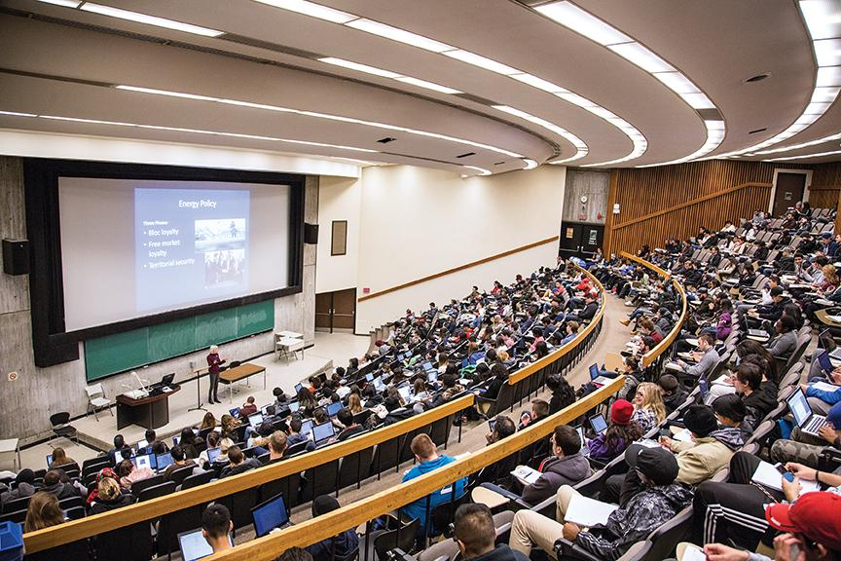
Leading from the Middle:
Engaging Your Institution in Integrating GNL
Series of awareness-building and
networking opportunities from
2015 – 2017 targeting:
Faculty members and support staff
Students
Findings from our work with faculty, staff, and students at York:
Current understanding of internationalization
Interest in and enthusiasm for integrating GNL pedagogy in their teaching and learning experiences
Diversity of faculty consultations (1:1 appointments)
Notes:
NAUSHEEN
As you saw from the video we just played, the Project Team began with a series of intensive workshops, meetings, and consultations, to facilitate opportunities for professional development and inter-faculty dialogue that emphasized an attempt to integrate GNL into both the culture and practice of the institution to promote internationalized teaching and the development of global competencies. The majority of these interactive sessions targeted faculty members - both tenured and contract - and support staff working in York University libraries, IT services, and Teaching Development (known as the Teaching Commons) units at the university. In addition to awareness-building and networking opportunities for faculty members and support staff, the Project team also coordinated several focus group sessions for the student body in effort to gauge the level of interest – and awareness of – internationalization of higher education and skills relevant for the 21st century global workplace amongst its undergraduate and graduate student populations across diverse disciplines.
Through these initiatives, we discovered that at York, the conception of internationalization is typically understood as a model that counts students, programs, and curriculum as international when there is a significant movement of knowledge or mobility of people between countries. Additionally, diversity at York is defined as a reflection of the presence of visible minorities in the classroom rather than a deeper, more nuanced understanding of how a diverse classroom might enrich the learning and teaching experiences of both students and faculty. In addition, we found that once faculty, staff, and students were exposed to the ways in which GNL might enhance internationalization efforts beyond existing programs at York – for example, satellite campuses, study-abroad programs) – they showed great enthusiasm in integrating GNL pedagogy in their teaching and learning experiences.

Slide 7
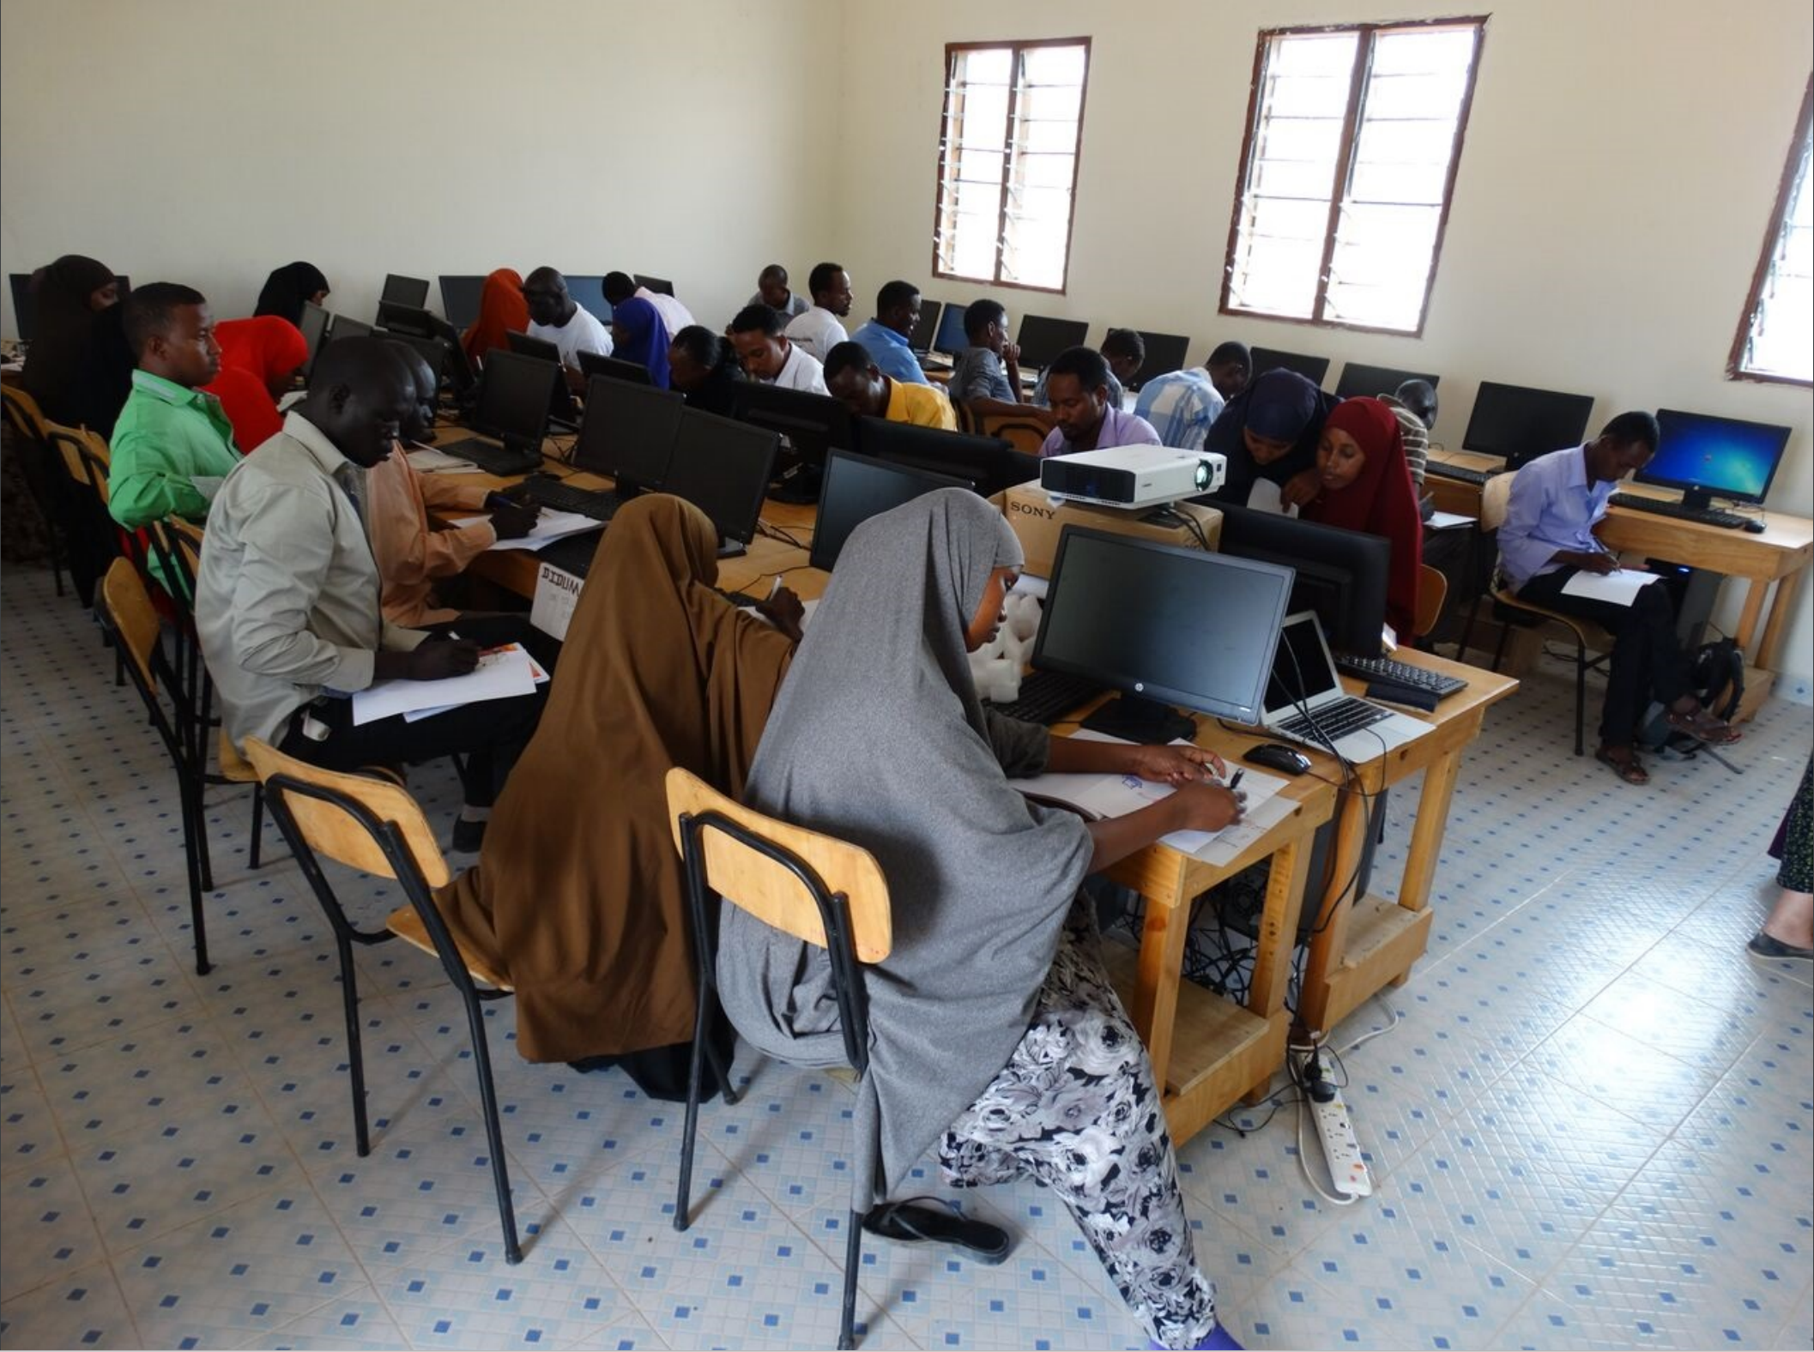
Leading from the Middle:
Engaging Your Institution in Integrating GNL
2. Collaboration with the Borderless Higher Education for Refugees (BHER)
BHER provided an example of a potential GNL case-study
Findings recorded in an ethnographic blog: challenges of online teaching/learning, problems that needed to be addressed at the institutional level before full launch of GNL initiative
Notes:
NAUSHEEN
In addition to these initiatives, the GNL Project team also worked closely with groups of faculty and staff that are currently delivering courses that offer variations of GNL. We began the Project by working with the Borderless Higher Education for Refugees (BHER) Project at York, which “aims to make educational programs available where refugees need them”. As part of this program, York University faculty members and BHER support staff design and deliver courses at both its Keele campus and satellite campus in Dadaab refugee camp, with the support of Teaching Assistants based in Canada, and instructors in Kenya. We worked closely with this team to study, learn from, and document the experiences of faculty members and team of graduate students (Teaching Assistants and Graduate Assistants provide various forms of instructional support).
Our findings were recorded in an ethnographic blog that highlighted the considerable challenges of online teaching/learning initiatives, problems that needed to be addressed by various units at York including the Registrar’s Office, IT services and Library systems, as well as issues with our Learning Management System – Moodle. For example, based one case-study of a first year undergraduate course in Geography that was taught to both sets of York students in Toronto and those in the Dadaab camp in Kenya, we found that the course Teaching Assistant had the most direct interaction with students, not the faculty member teaching the course itself. Furthermore, it was difficult to connect the two classrooms together because of various technical issues. Because of these issues, what ended up happening is that the lectures were pre-recorded, whereby audio was recorded live during lectures delivered to the York-based students and then mapped onto the powerpoint slides through Camtasia recorder, and the raw files were then sent the course Assistant for editing and uploading to Moodle via the Camtasia relay server.
Moodle itself presented many issues for the Course Teaching Assistant and Graduate Assistant. As they noted, they didn’t know how the Dadaab cohort was actually accessing the video lectures and other content on Moodle, and when. This was crucial since they were often changing and moving things around a lot on Moodle. This was frustrating for both instructional team members and students themselves; they have noted that “Moodle – and the York system – isn’t, at least for the moment, fully cut out for distance learning projects like BHER.”
Beyond issues of infrastructure, we also found that individual faculty members delivering these courses had different levels of comfort using and integrating technology for GNL courses. Such form of data collection opened our eyes to the relative lack of preparedness of York’s current infrastructure and culture in developing and sustaining a pan-university GNL model.
Beyond these issues, faculty members acknowledged themselves that they were relatively unprepared for collaborative activities between classrooms. One faculty member (Don Dippo) for example noted that he had assumed the collaborative activities he had set up would be equally appealing to both York University students in Toronto and those in Dadaab. But, as he soon found out, students in different contexts placed different value on both the quality and quantity of online participation. It was also challenging for the same faculty member to teach across borders where the system of education itself is different, as is the purpose of education.
From our conversation with him, we recognized that the notion of the classroom, the student, and value and purpose of education, as well as assessments are conceptualized differently in a cosmopolitan city in the Global North from that in a conflict refugee camp in the Global South. Integrating marginalized voices from different political, economic and social contexts are very important for developing intercultural skills for students in the Global North, but in the process of course design and implementation, we must be critical in the ways in which we integrate these voices in higher education. For example, how does being connected to classrooms outside of the refugee camp benefit or present problems for those students themselves?

Slide 8
Leading from the Middle:
Engaging Your Institution in Integrating GNL
3. Development of online presence to collect and curate key messages about the GNL at YorkU Project for faculty, staff, and students via:
Website
Social media platforms (Facebook, Twitter, YouTube channel)
Instructional videos
Instructor Guide
Notes:
NAUSHEEN
The GNL Project team also launched a website, developed social media platforms (Facebook, Twitter, and a YouTube channel), and developed instructional videos and an instructor guide as a means to collect and curate key messages related to GNL that extends the concept of internationalization to consider notions of global competencies. For example, the Project team emphasized GNL as a means to “bring together [students, faculty and librarians] in a consortium to collaborate on projects that bring together the diverse perspectives of participants to produce a richer, more nuanced, understanding of the issue(s) at hand” (Globally Networked Learning, n.d.). These ideas mirror a slow, yet noticeable, shift in the institution’s understanding of intercultural competence and global citizenship, which have begun to be more heavily promoted by senior university administration. We found that despite this renewed focus on a global perspective, however, GNL as both a form of internationalization and the development of global competencies remains a complex intersection of ideas that have proven to be challenging to communicate, integrate, and implement.
Through these 3 types of initiatives, the Project team began its process of developing its own community of practice from the “middle.” Currently, this community of practice consists of faculty members, IT and library support staff, and a team of graduate students from its two campuses in Canada (one of which is bilingual) who have helped to identify possible initial challenges and important gaps in resources and/or support for those faculty members interested in developing and mounting GNL courses. It is from our engagement with this community of practice that we are now preparing proposals for enhancing current processes to propose the development of a GNL infrastructure at York. Now in its third year of funding, the GNL Project team is working with other units at the university to finalize a proposal for the organizational architecture for a GNL model at York that can provide continuous and meaningful support to faculty and staff that are rethinking their curriculum for the internationalized classroom, and for the students and young scholars who will be taking these exciting courses.

Slide 9
Benefits: Lessons Learned from the GNL Project Team
Benefits: Largely a result of our place and perspective within the institution
Our ability to connect with pan-university, interdisciplinary Faculties, both in terms of their students and faculty members
Our success in debunking initial conceptualizations of GNL pedagogy as being synonymous with online, open curriculum development
Our ability to extend and expand faculty dialogues to consider integration of interculturality into current curriculum
Notes:
LISA/ DOMINIQUE
There have been many benefits to leading from the middle. One of our biggest achievements has been our ability to connect with pan-university, interdisciplinary Faculties, both in terms of their students and faculty members. The range of faculty members and students that have shown interest in GNL - because of the innovativeness of the pedagogy and the possibilities it opens up to acquire crucial and relevant skills - is very diverse, contrary to what we have initially assumed. We are building on this achievement now to conduct a large-scale needs assessment of the different Faculties at York, so that faculty members and students are well poised to begin and succeed in teaching of, and learning from, GNL courses. A survey is being developed currently to assess the understanding and adoption of the GNL pedagogy from Ontario teachers from elementary to secondary levels, and GNL workshops are planned to train them this Spring and Summer 2018. Over the next few months, we will be meeting with Deans and Associate Deans of each Faculty to understand type of GNL model that would work best for faculty, staff and students in their diverse departments. A needs assessment of lateral structures within the university will ensure that the model that is implemented works for, and across the unique features of, each Faculty (9 in total).
Similarly, the GNL Project has been successful in debunking initial conceptualizations of GNL pedagogy as being synonymous with online curriculum development. This re-formulation has been encouraging for incoming BHER Project faculty members who wished to experiment with GNL rather than continue with the tradition of online teaching to student cohorts in the Dadaab refugee camp in Kenya. After two and a half years of sustained work with a wide range of faculty from different disciplines, we have brought about awareness that GNL pedagogy is less about merely connecting classrooms via different forms of technology, and more about the co-development of curriculum and a meaningful partnership to engage students on global issues. We have also taken a cross-section of the diverse courses offered at the undergraduate level that might benefit from the addition of GNL modules and identified how and in what ways partnerships may be established, and GNL components may be added in.
These benefits are largely a result of our place and perspective at the institution. Given that our Project team itself reflects the so-called middle, we have been able to access faculty members, staff, and students who have been instrumental in identifying and shaping the needs of the different stakeholder groups. These groups helped in opening the doors to lateral structures in the institution that would ultimately house GNL programs and curriculum, and in getting the Project team to think through how we might incentivize these groups to take part in GNL teaching and learning. As part of our needs assessment of different Faculties, we are in the process of identifying what these incentives might look like for different tiers of faculty, undergraduate and graduate students, and support staff.

Slide 10
Barriers: Lessons Learned from the GNL Project Team
Barriers: Multiple barriers to implementing such a large-scale initiative from our place and perspective of the ‘middle’
Challenges with bringing together highly interconnected units, resources and perspectives that had not previously been brought together
Difficulties of introducing the concept of 21st century skills as an outcome of GNL pedagogy
Catalyzing the institutional change that is needed to embark on GNL
Notes:
LISA/ DOMINIQUE
Yet, despite these benefits of organizing from the middle, the GNL project team encountered multiple barriers to implementing such a large-scale initiative from their place and perspective at the institution. It was readily apparent that such a project would rely heavily on networks and relationships; while each team member was well connected in their own department and immediately surrounding areas, it became clear that a pan-institutional network was required to encourage the rapid yet intentional and timely dissemination of information.
The Project team recognized very quickly that in order for a GNL model to be successfully implemented, and function effectively, at York University, it needs to bring together a wide range of units into communication with each other, and equally, to ensure that faculty members who are developing and mounting courses are aware of, and know how to navigate, the organizational structure that currently exists. Our experience of working with core faculty members suggests that they do not necessarily know of the range of support systems that are already in place, and/or how they might seek out additional support should they wish to troubleshoot various aspects of their course, or request support from qualified and relevant educational developers and/or IT support. As evidenced by our ethnographic blog of the BHER Project, this is a key barrier for many faculty who are keen to embark on the process of developing GNL courses or GNL modules. Some faculty members have had to – often unknowingly – develop, troubleshoot, and negotiate various aspects of their courses or modules while support at the university is already there. In other cases, they have resorted to finding various unique solutions to their challenges in silos. This has meant that there is limited record of the institutional challenges faced, and the solutions that may be used; as such, there is the potential for reinventing the wheel, and wasting considerable time, effort and energy – all of which serve as disincentives for those who wish to innovate. With the inception of the Project, and the subsequent development of a community of practice, some aspects of knowledge mobilization and the development of institutional memory are slowly being addressed.
Leading from the middle meant that the information and resources created to support this initiative were made up of several distinct yet highly interconnected parts, often drawing from multiple resources and perspectives that had not yet been brought together through regular curriculum development or review. While an emphasis on interdisciplinary curriculum and learning is not new to York University, working at the ground level to encourage innovation within individual classrooms represented a challenge not often faced by senior administration. This project work represented the other side or half of university-wide initiatives, attempting to inspire change and integrate curriculum components without a direct incentive or clear direction and guidance coming (only) from those who typically and publically lead such work. Mirroring similar challenges at the institutional level, the project team quickly learned that an emphasis on collaboration and communication was required beyond, or at least before, the work of education and implementation.
Additionally, it has been challenging to introduce the concept of 21st century skills as an outcome of GNL pedagogy to the different stakeholders we are working with in higher education. While such research and material is readily available in relation to K-12 education across the province of Ontario, it is less readily available for post-secondary education. The GNL Project team is proposing to explore this connection via a new AIF project, tentatively titled “Knowledge Translation Across Cultures: Developing 21st Century Skills Among Undergraduate Students”. This project is part of a proposed program on Civic and Social Stewardship / Responsabilité civique et sociale to be offered on the bilingual campus of York university. It will create a framework of open pedagogy (Open Educational Resources (OER), n.d.), designed as a series of resources and activities. This holistic program aims to embed student success and community-based experiential education strategies by creating an 18-credit Certificate in Civic and Social Stewardship that students can participate in alongside their majors locally and globally. It will also employ a cohort or learning community-based model which has been demonstrated to positively impact student success.The framework will be built using evidence-based practices for effective teaching and learning, guided, in part, by a partnership with the Teaching Commons and York International. The proposed bilingual framework in open curriculum aims to support students in developing the skills essential for success in the 21st century university. These skills include i) understanding interculturality; ii) communicating across languages and cultures; and iii) critical thinking and research skills. Drawing on P21 Partnership 21st Century Learning which identifies these skills, and York’s strategic priority of internationalization, this project will aim to create a practical means for faculty to embed opportunities for such skill development in their courses. We believe that the proposed project will enhance the reputation of the university by preparing students for success in a 21st century workplace that demands skills in global and intercultural competence. It will answer the needs of students going abroad in exchange or those of International students enrolled in York various programs. It will build on the findings from this current GNL Project that explored the integration of a globally networked learning (GNL) pedagogy across campus, bringing together an interdisciplinary project team with the goal of inspiring pilot courses, providing support for integrating GNL teaching and learning strategies into existing courses, and researching new models for cross-cultural academic projects.
In an attempt to catalyze the change needed in current institutional practices and infrastructure, the Project team has embarked on the concurrent efforts to engage different Faculties and to secure ‘buy-in’ for GNL as a form of internationalization and as a model for delivering crucial skills for teachers and learners from senior administration at York University. As we embark on the final phase of the Project, the Project team will meet with various members of senior administration – at the level of the Provost and Vice-Provosts of Teaching and Learning – at York University to ensure they are familiar with, and see the potential for, GNL as an innovative approach to learning and teaching in higher education today. Given our place in the middle of the institution, with senior administrators in the Project team itself, initiating these sets of very important meetings has been relatively easy. We have prepared our research, have sufficient data from our existing environmental scan of two years to show both the importance of GNL; as to whether we have the buy-in from higher level administration, we have yet to see. We believe that this buy-in is crucial for the needed direction and guidance from those stakeholders that typically lead such work at the institution.

Slide 11
Questions to Consider: Leading from the Middle
Where is your community of practice on campus? Who are your champions?
What does GNL mean to you? What does it mean at your institution? How clear and consistent is your messaging?
How will you make your students the stewards of this pedagogy?
Notes:
LISA

Slide 12
QUESTIONS?
gnl@yorku.ca
Dominique Scheffel-Dunand dsdunand@yorku.ca
Lisa Endersby lendersb@yorku.ca
Nausheen Quayyum nquayyum@yorku.ca
Notes:
LISA

